Slide 1



ORIENTED-OBJECT PROGRAMMING PROJECT
INTERACTIVE SIMULATION OF FORCES’S COMPOSITION
- GROUP 6 -

Slide 2




TEAM MEMBERS
Hoàng Khải Mạnh
-20225984-
Nguyễn Thị Thu Huyền
-20220073-
Hoàng Quốc Hưng
-20226043-
Trương Linh Duyên
-20225968-

Slide 3
I. INTRODUCTION

Slide 4

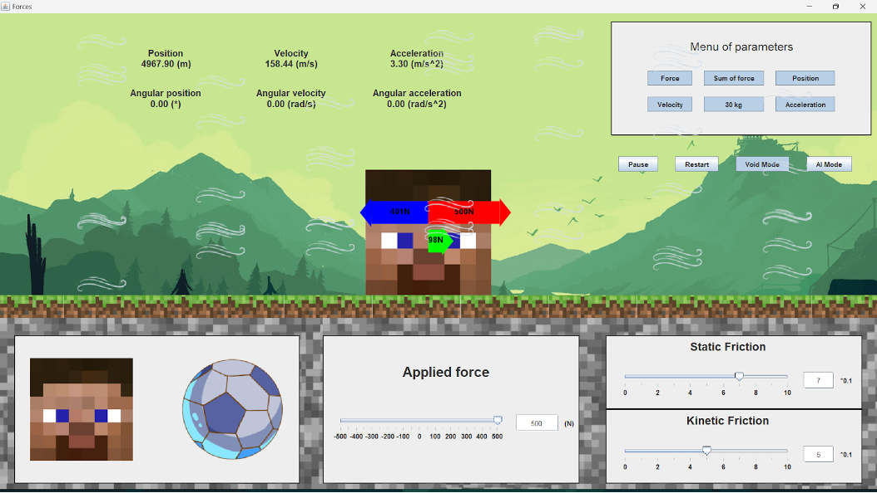

INTRODUCTION
Newton’s laws of motion are the foundation of dynamics.
These laws provide an example of the breadth and simplicity of principles under which nature functions.
Basic knowledge: Gravitation force, normal force, friction, Newton’s laws of motion, Newton’s law for rotation.
In this project, we create a interactive simulation for demonstrating Newton’s laws of motion.

Slide 5
II. DESIGN

Slide 6

1. MAIN OBJECT

Slide 7


1.MAIN OBJECT
Cylinder-shaped object
Cube-shaped object
Parameters:
Radius
Mass
Parameters:
Side-length
Mass

Slide 8
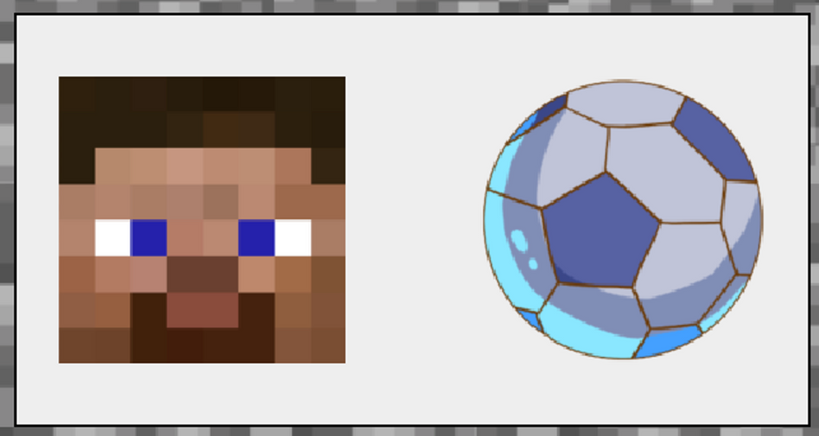
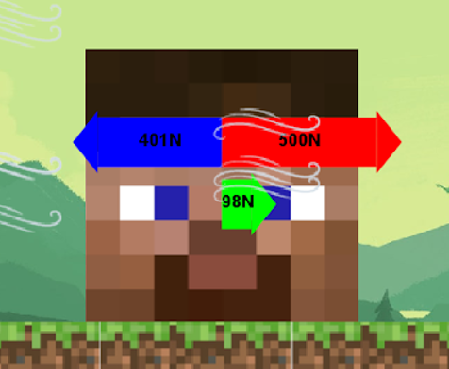
1.MAIN OBJECT
The user can specify the desired parameters by click on the object in the menu on bottom left
Then the object will pop up on the surface.

Slide 9
2.SURFACE

Slide 10
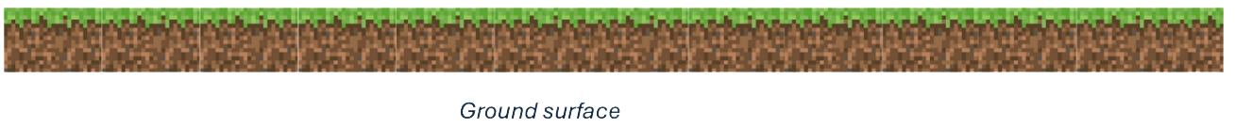

2.SURFACE
Ground surface
Ice surface
The surface moves according to the direction and speed of object’s move.
Surface changes state according to the friction impacting on object:
Ground: friction exists
Ice: friction disappears

Slide 11
3.FORCES CONTROLLER

Slide 12
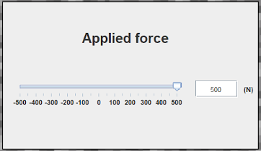
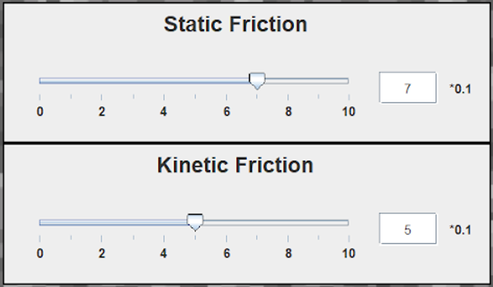
3.FORCES CONTROLLER
The user can control the applied force and friction coefficients of the surface
There are two friction coefficients: static friction coefficient and kinetic friction coefficient. For each coefficient, the user can control its value through a sliding bar and a text box

Slide 13
4.CONTROL PANEL

Slide 14


4.CONTROL PANEL
Applying AI model to adjust the applied force not by the manual way
Remain the state when click the button
Air resistance
Reset all the parameters

Slide 15



5.MENU OF PARAMETERS

Slide 16
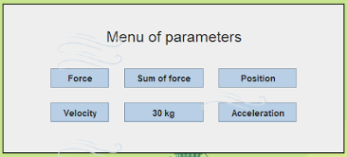
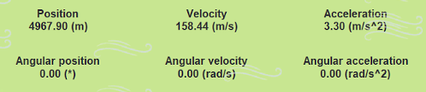



5.MENU OF PARAMETERS
Choose to show or hide detailed information such as the forces, the sum of forces, the values of forces, the mass, speed and acceleration of the main object.
Table of parameters
Force
Sum of force

Slide 17
5.MENU OF PARAMETERS
Choose to show or hide detailed information such as the forces, the sum of forces, the values of forces, the mass, speed and acceleration of the main object.
Table of parameters
Force
Sum of force

Slide 18
III. ADDITIONAL MODES

Slide 19
1. AIR MODE
Create air resistance force causing friction to increase based on object’s speed
Simulating the air environment which changes state according to object’s move
→ More realistic simulation

Slide 20
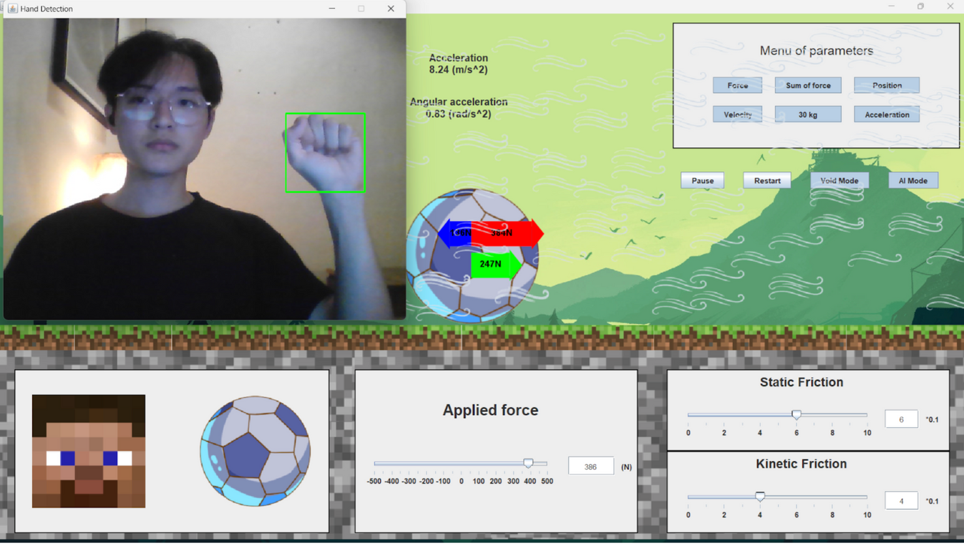
2. AI MODE
Using AI model to detect the position of hand on camera and change the applied force respect to that

Slide 21
THANK YOU

